Slide 1

Automation in Indian Postal System
A Mid Term Presentation on
BY:
Ankita Patel 100110107049
Mehul Gupta 100110107005
Department of Computer Engineering,
G H Patel College of Engineering & Technology,
Bakrol Road,
Vallabh Vidyanagar-388 120, Gujarat

Slide 2
Table of Contents
Introduction
Automatic Mail Processor Block Diagram
Pre-Processing
Address Block Location
Segmentation Techniques
Line Segmentation Module

Slide 3
Introduction
The Indian Postal System is one among the few public sector units which deserve to be fully automated.
The time taken for delivery a mail is the sum total of the transit time and processing time.
The transit time is something which is inevitable.

Slide 4
But, the processing time, which includes the time for mail address interpretation and sorting, can be reduced to a great deal if the sorting process is automated.
Consider a mail that is posted from Coimbatore to Shimla. The existing postal system involves human intervention in the processing of this mail at least four times: Coimbatore, Chennai, Delhi and Shimla.

Slide 5
This process of mail sorting is highly time consuming besides being error prone.
This is why we feel the urgency to bring
Automation in the Indian Postal System.

Slide 6
Automatic Mail Processor Block Diagram
Digitization
Binarization
Address Block Location
Line Segmentation
Word Segmentation
Address Parsing and Recognition
Delivery Point Code Generation
Bar Coding

Slide 7
Pre-Processing
Digitization
Method to obtain Digitized image of the document(i.e. mail)
The image can be obtained either by using Camera or a Scanner
We obtain a 24 bit RGB image.

Slide 8
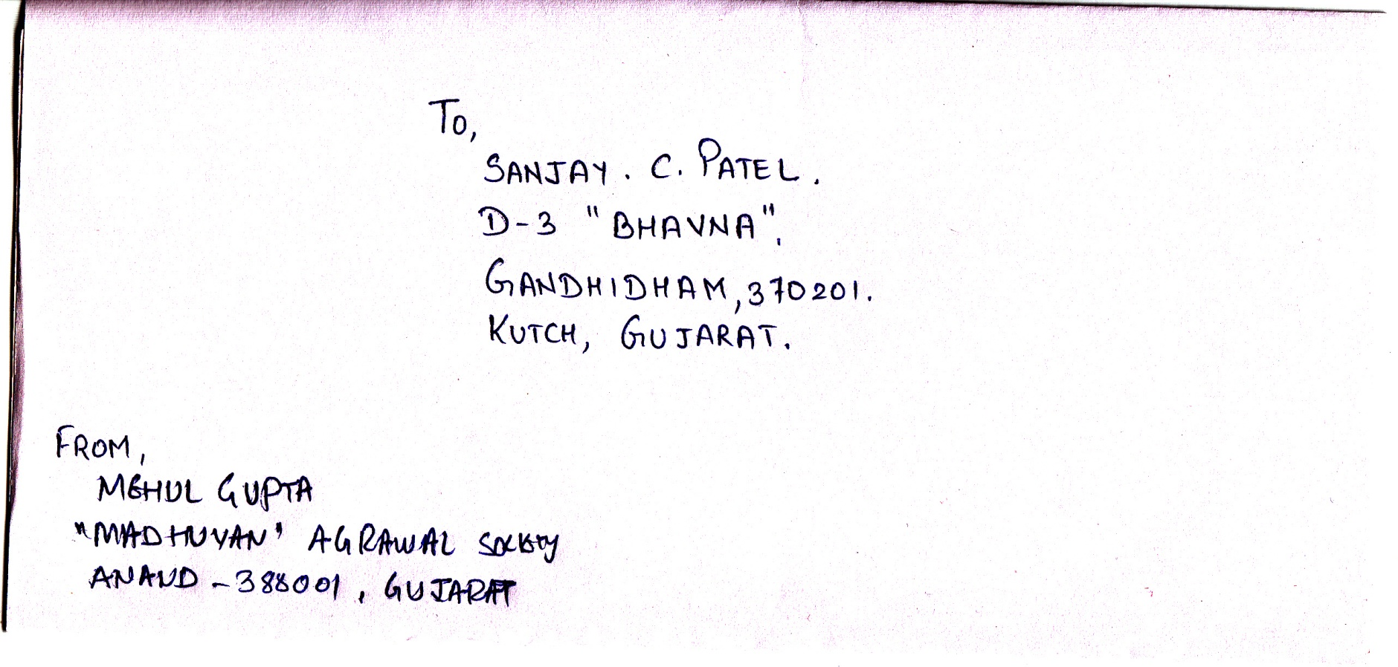
Digitized Image, obtained using a scanner

Slide 9
De Noising
It is necessary to remove Noise from the image. Thereby Increase the performance of our system.

Slide 10

Noise Present in the image

Slide 11
Binarization
The RGB image is converted to Black-White image.
Now each pixel need only 2bits to represent the color.
Where, 0 – Black
And 1 - White

Slide 12
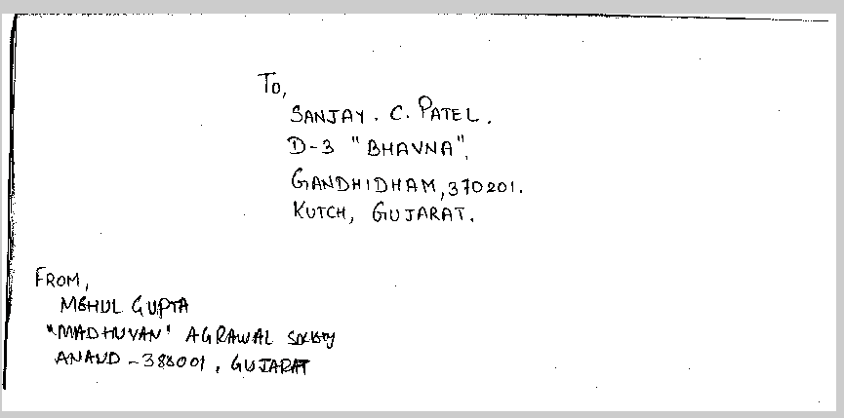
Binarized and De Noised Image

Slide 13
Address Block Location
The location of the destination address in an envelope is not pre-determined.
This necessitates the need for an Address Block Location module (ABL).
The ABL returns the coordinates of a rectangle with least area that can be drawn around the destination address after leaving a tolerance level.

Slide 14
Redundancy Correction (RC) Algorithm
1. Obtain the image from pre processing unit
2. Low pass filter the image using a 20 X 20 spatial mask using point processing techniques.
3. As the low-pass filtered image is a non-binary image, re-binarize it by setting a high threshold value.
4. The Re-Binarization would cause the fields on the envelope to form black patches.
5. As the redundant information such as the sender’s address and the stamp impressions are usually present only in the corner of an envelope, they can be removed by scanning through the image.
6. The resultant image now has a white back ground with back patches only in the destination address.
7. After leaving a tolerance, a rectangle is suitably positioned over the destination address patch and its coordinates are returned.

Slide 15
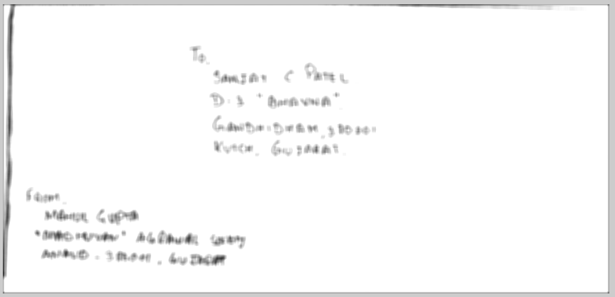
Low Pass Filtered Image

Slide 16
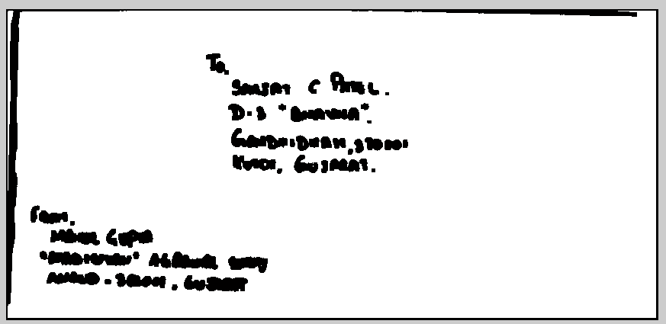
Re – Binarized Image

Slide 17
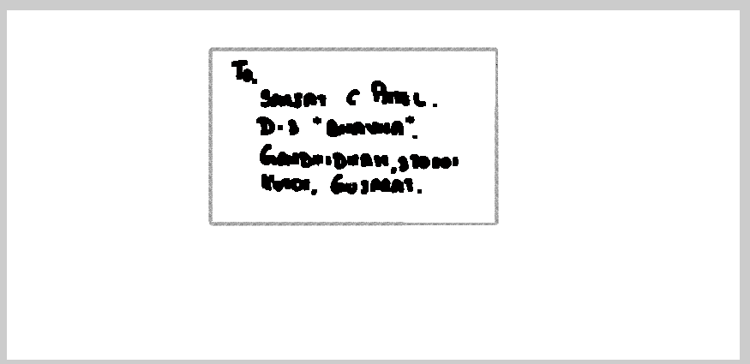
Redundancy Corrected image

Slide 18
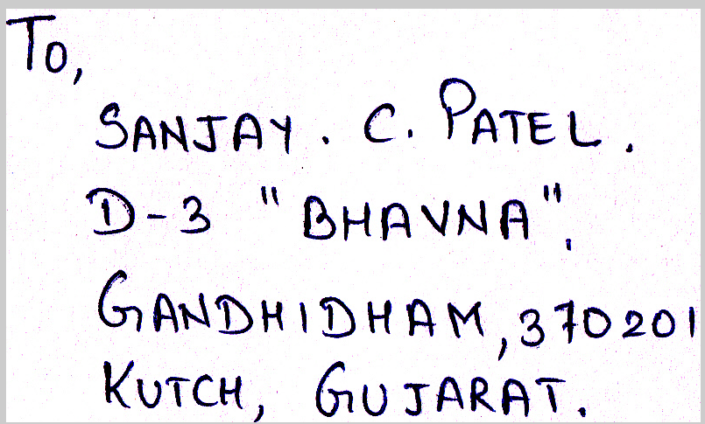
Extracted Address

Slide 19
Segmentation Techniques
Pixel Approach
Histogram Approach
Smearing Method
WaterFall Algorithm

Slide 20
Pixel Approach
1. Scan the extracted image pixel-row by pixel-row.
2. Set a threshold value for the minimum number of white pixel rows to be present between two address lines.
3. A predefined amount of tolerance is provided while deciding whether a pixel-row is a white pixel-row for avoiding ‘y’ – ‘f’ problem.
4. Count the number of consecutive white pixel rows.
5. If the number of white pixel rows is greater than the threshold, then separate the two address lines.
6. Repeat steps 4 and 5 until all the address lines have been separated.

Slide 21
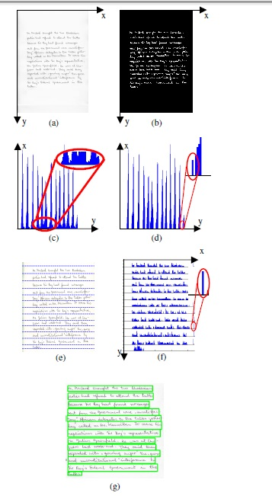
Histogram approach

Slide 22
Smearing Method
In smearing methods, the consecutive black pixels along the horizontal direction are smeared consequently; the white space between black pixels is filled with black pixels. It is valid only if their distance is within a predefined threshold. This way, enlarged areas of black pixels around text are formed. It is so-called boundary growing areas. These areas of the smeared image enclose separated text lines. Hence, obtained areas are mandatory for text line segmentation.

Slide 23
Water fall Method
Original water flow algorithm proposed, assumes hypothetical water flows under a few angles of the document image frame from left to right and vice versa. In this hypothetically assumed situation, water is flowing across the image frame. For the water flows from left to right, the situation is shown in Figure 11. Areas that are not wetted form unwetted ones. The stripes of unwetted areas are labelled for the extraction of text lines. Further, this hypothetical water flow is expected to fill up the gaps between consecutive text lines. Hence, unwetted areas left on the image frame lies under the text lines. Once the labelling is completed, the image is divided into two different types of stripes. First one contains text lines. The other one contains line spacing.

Slide 24
Unwetted area definition

Slide 25
United unwetted areas

Slide 26
Line Segmentation Module
Horizontal Scanning (HS) Algorithm /Pixel Algorithm
The Horizontal scanning algorithm that is used for line separation is described below.
1. Scan the extracted image (Figure 13) pixel-row by pixel-row
2. Set a threshold value for the minimum number of white pixel rows to be present between two address lines.
3. A predefined amount of tolerance is provided while deciding whether a pixel-row is a white pixel-row for avoiding ‘y’ – ‘f’ problem.
4. Count the number of consecutive white pixel rows.
5. If the number of white pixel rows is greater than the threshold, then separate the two address lines.
6. Repeat steps 4 and 5 until all the address lines have been separated.

Slide 27
Line Segmentation using Pixel Method

Slide 28
Line Segmentation using Histogram Method

Slide 29
Future Work
Word and Character Segmentation
Character Recognition
Address Parsing and Recognition
Delivery Point code generation and Barcoding

Slide 30
Thank You

Slide 31
Any Questions.

